Slide 1




Regular Expressions
/^Hel{2}o\s*World\n$/
SoftUni Team
Technical Trainers
Software University
http://softuni.bg

Slide 2

Table of Contents
Regular Expressions
What are they
When to use them
Why to use them
Characters, Operators, Constructs
Helpful Resources

Slide 3
Regular Expressions. What are they?
A regular expression is:
A sequence of characters that forms a search pattern
Mainly for use in pattern matching with strings
Also known as regex, regexp, rational expression
Each character in a regular expression is either
A metacharacter with its special meaning
A regular character with its literal meaning.

Slide 4
When To Use Regex?
See if a string contains certain things
When we want to see if a password contains both uppercase and lowercase characters, numbers,special characters, etc..
Replace operations
When we want to replace two or more spaces with one
Check if a string matches a certain pattern
When we want to validate a phone number

Slide 5
Why To Use Regex?
While it is possible to solve common problems using methods like “char-by-char crawling”, using regular expressions grants you much more flexibility with a lot less typing.
Regular expressions are integrated in most modern programming languages.
It makes you look like the ultimate badass hacker to the untrained, not knowing Regex eye.

Slide 6
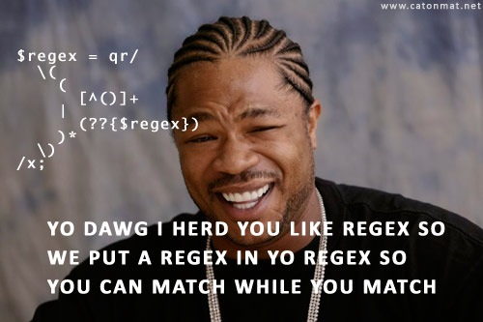
Characters, Operators, Constructs

Slide 7
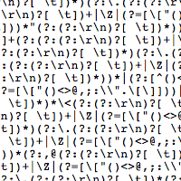
What Character Types Exist In Regex?
Character Escapes
Character Classes
Anchors
Grouping Constructs
Quantifiers
Backreference Constructs
Alternation Constructs

Slide 8
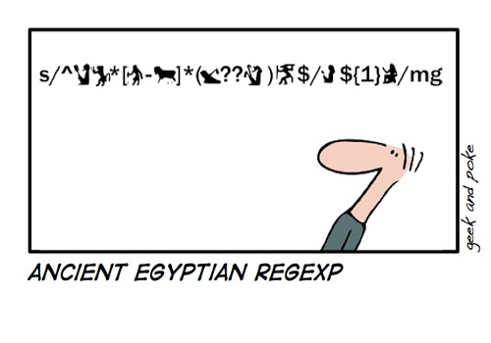
Character Escapes
The backslash character (\) in a regular expression indicates that the character that follows it either is a special character, or should be interpreted literally

Slide 9
Character Escapes
\t - Matches a tab
\n - Matches a new line
\unnnn - Matches a Unicode character by using hexadecimal representation (\u0061)
\xnn - Uses hexadecimal representation to specify a character (\x30)
\ - When followed by a character that is not recognized as an escaped character matches that character (\.)

Slide 10
Character Classes
A character class matches any one of a set of characters.

Slide 11
Character Classes
[character_group] - Matches any single character in character_group ([abc])
[^character_group] - Negation: Matches any single character that is not in character_group ([^abc])
[first-last] - Character range: Matches any single character in the range from first to last ([a-z])

Slide 12
Character Classes (2)
. - Matches any single character except \n.
\p{name} - Matches any single character in the Unicode general category (\p{Lu} - matches any Letter, uppercase) * **
\w - Matches any word character **
\s - Matches any white-space character **
\d - Matches any decimal digit **
* - Not so common ** - Has an inverted substitution

Slide 13
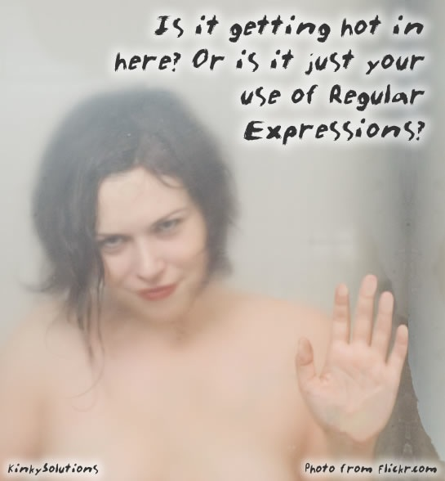
Quantifiers
A quantifier specifies how many instances of the previous element (which can be a character, a group, or a character class) must be present

Slide 14
Quantifiers
* - Matches the previous element zero or more times
+ - Matches the previous element one or more times
? - Matches the previous element zero or one time
{n} - Matches the previous element exactly n times.
{n,} - Matches the previous element at least n times.
{n,m} - Matches the previous element at least n times, but no more than m times.
* - Not so common ** - Has an inverted substitution

Slide 15
Anchors
Anchors, or atomic zero-width assertions, cause a match to succeed or fail depending on the current position in the string

Slide 16
Anchors
^ - The match must start at the beginning of the string or line
$ - The match must occur at the end of the string or before \n at the end of the line or string.
\b - The match must occur on a boundary between a \w (alphanumeric) and a \W (non-alphanumeric) character **
\G - The match must occur at the point where the previous match ended (\G\(\d\) - "(1)", "(3)", "(5)" in “(1)(3)(5)[7](9)") *
* - Not so common ** - Has an inverted substitution

Slide 17
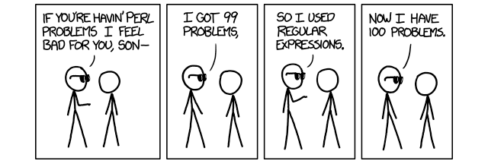
Grouping Constructs
Grouping constructs delineate subexpressions of a regular expression

Slide 18
Grouping Constructs
(subexpression) - Captures the matched subexpression and assigns it a one-based ordinal number
(?<name>subexpression)- Captures the matched subexpression into a named group ((?<number>\d)) *
(?:subexpression)- Defines a non-capturing group.
(?=subexpression)- Positive lookahead
* - Not so common ** - Has an inverted substitution

Slide 19
Grouping Constructs (2)
(?!subexpression)- Negative lookahead
(?<=subexpression)- Positive lookbehing *
(?<!subexpression)- Negative lookbehind *
* - Not so common ** - Has an inverted substitution

Slide 20
Backreference Constructs
A backreference construct allows a previously matched subexpression to be identified in the same regular expression.

Slide 21
Backreference Constructs
\number - Backreference. Matches the value of a numbered subexpression
\k<name> - Named backreference. Matches the value of a named expression *
* - Not so common ** - Has an inverted substitution

Slide 22
Alternation Constructs
An alternation construct modifies a regular expression to enable either/or matching.

Slide 23
Alternation Constructs
|- Alternation. Matches any one element separated by the vertical bar (|) character
(?(expression )yes|no) - Matches yes if the regex pattern expression matches; otherwise, matches the optional no part *
(?(name) yes|no)- Matches yes if name, a named or numbered capturing group, has a match; otherwise, matches the optional no *
* - Not so common ** - Has an inverted substitution

Slide 24

Helpful resources

Slide 25
Helpful Resources
http://regexr.com - A website to test Regex using JavaScript
http://regexhero.net - A website to test Regex using C#
http://msdn.microsoft.com/en-us/library/az24scfc(v=vs.110).aspx - Quick Reference for Regex from Microsoft.
http://regexone.com - Interactive tutorials for Regex
http://www.phpliveregex.com - Used to test Regex using PHP

Slide 26
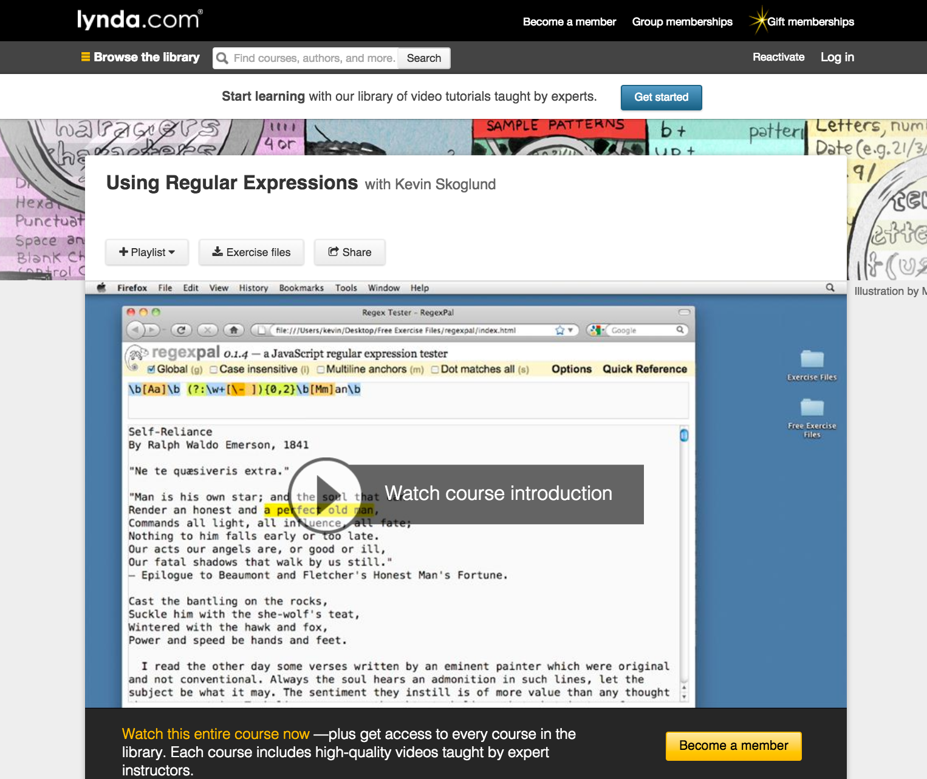
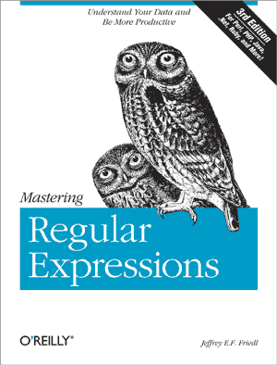
Helpful Resources (2)

Slide 27







Regular Expressions
https://softuni.bg/courses/php-basics/

Slide 28

License
This course (slides, examples, demos, videos, homework, etc.) is licensed under the "Creative Commons Attribution-NonCommercial-ShareAlike 4.0 International" license
Attribution: this work may contain portions from
"PHP Manual" by The PHP Group under CC-BY license
"PHP and MySQL Web Development" course by Telerik Academy under CC-BY-NC-SA license

Slide 29




Free Trainings @ Software University
Software University Foundation – softuni.org
Software University – High-Quality Education, Profession and Job for Software Developers
softuni.bg
Software University @ Facebook
facebook.com/SoftwareUniversity
Software University @ YouTube
youtube.com/SoftwareUniversity
Software University Forums – forum.softuni.bg

